Slide 1
Agile Software Engineering
.Net
Jan Sabbe, Ronald Dehuysser
20 - 21 March 2017
Notes:
Wouter

Slide 2

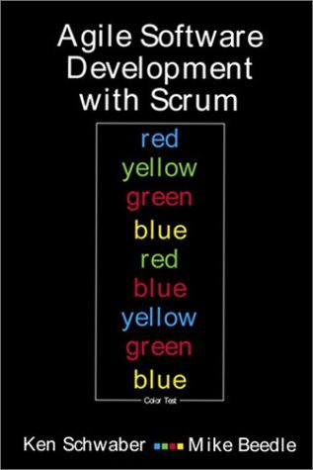
Agile software development
XP
Scrum
Notes:
2 min
Scrum: planning
XP: development

Slide 3
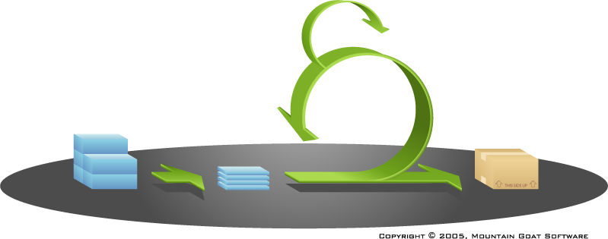
Scrum
Daily scrum
Sprint
Backlog
Stories

Slide 4
eXtreme Programming
Incremental design
Pair programming
Simplicity
Small releases
Change
Test Driven Development
Communication
Values
Practices
Sustainable pace
Feedback
Shared code
Courage
Refactoring
Continuous integration
Continuous build
Notes:
3 min
Extreme programming practices + extra agile engineering practices
Eenvoud: hou het simpel, niet direct beginnen met gigantische designs
Communicatie: focus op directe, mondelinge communicatie; ook zorgen voor communicatieve code
Feedback: snelle feedback via testen, functionele testen, customer feedback. Geen 4 maand wachten op resultaten
Moed: om eerlijk te zijn als iets niet goed gaat. Ook dit dan durven aan te pakken. Zowel code als teamwerking
Verandering: flexibel zijn, code moet makkelijk aanpasbaar zijn. Ook veranderingen in team moeten mogelijk zijn.

Slide 5
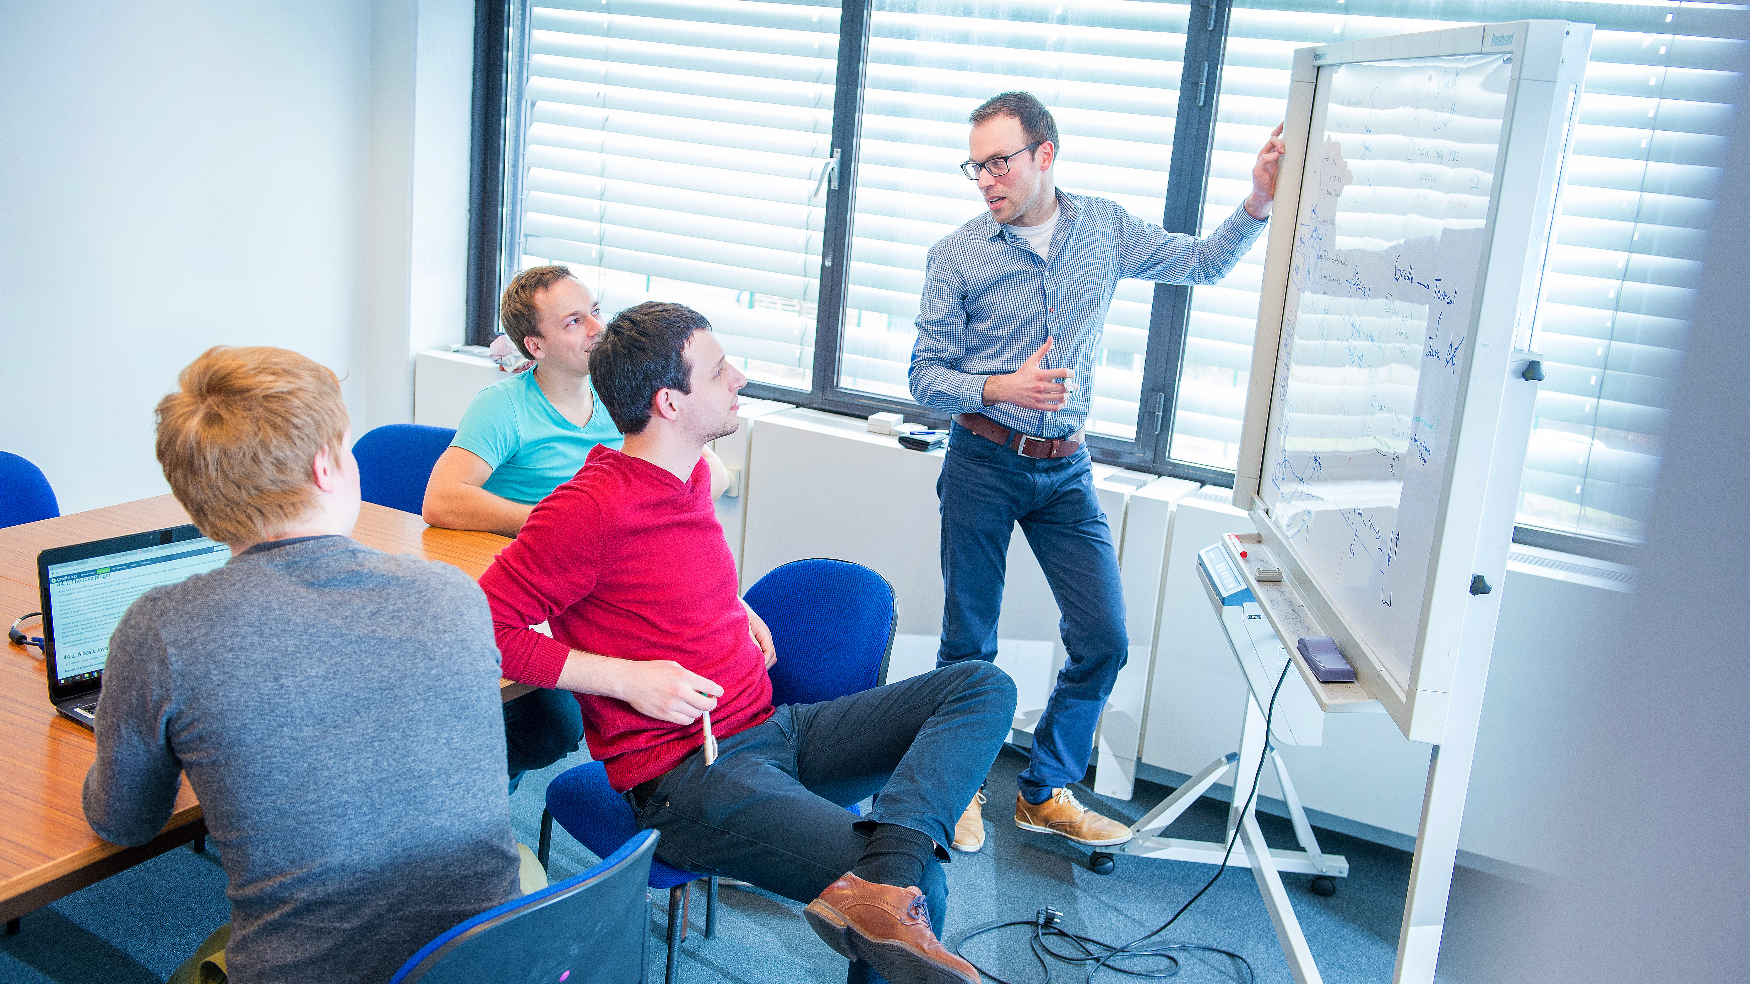
Life of a story

Slide 6
Life of a story
Pick a story
Design
Develop
Proxy test
Done

Slide 7
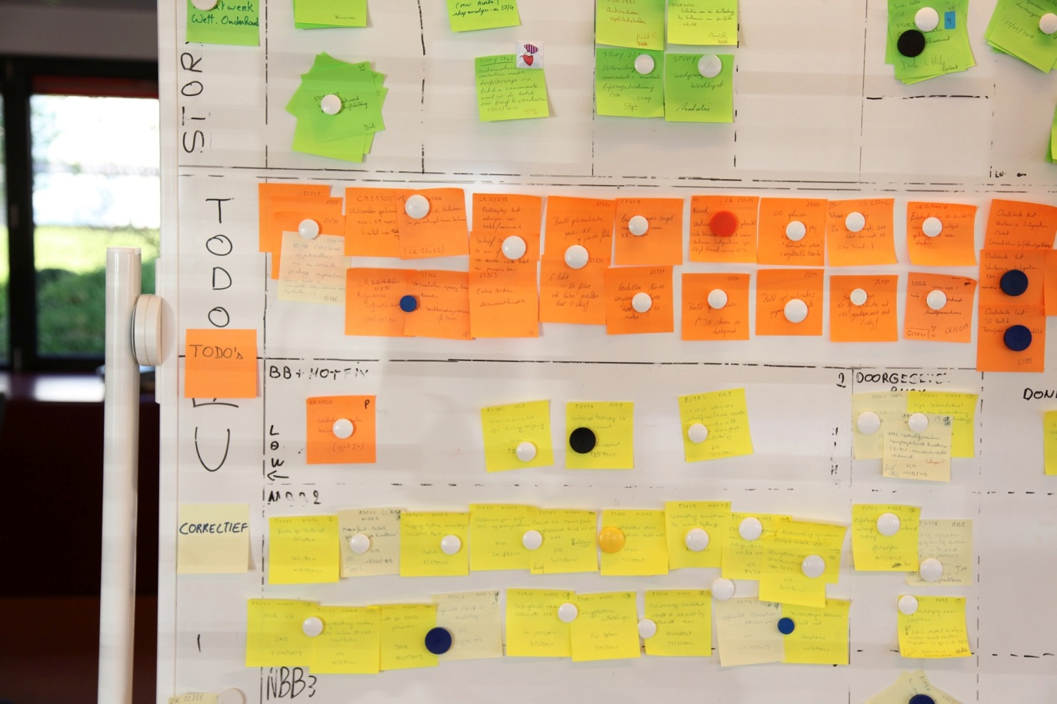
Pick a story
big, risky, valuable stories first
team decision
stop starting, start finishing
Notes:
Picking big/risky stories first, allows proxy enough time for testing and giving feedback.
Entire team! Not just developers, include proxy, scrum master,..
Prefer helping on a story that is already busy over starting a new story
Better to finish 1 story than to start 10
Give tester more time to test and allow time to fix some bugs coming out

Slide 8
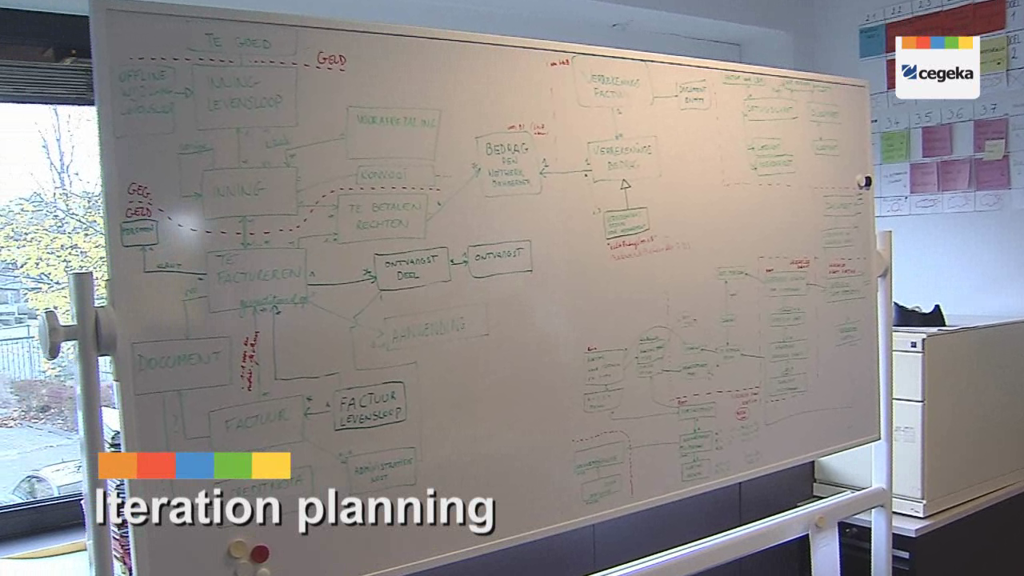
Get the story on the board
design what’s needed for story
use whiteboard not a complex tool
focus on this story, not the next
involve entire team
Notes:
visio/… official uml diagrams is a waste of time (take a picture and put it on a wiki if you want to remember something
It is a continuous process, for every story
Don’t design everything at once. You’ll improve the design with each story by refactoring. Zinloos om groot design op te zetten, en dan te merken dat volgende week alles weg mag. Reden: up front ken je niet alle requirements.
Het kan wel zinvol zijn om al voor een milestone/feature al een idee te hebben naar welk model je wil toegaan, en dat je daarbij al een iets groter domein model uittekent. Gewoon nog niet alles uittekenen
Waarom?: embracing change: kunnen omgaan met verandering.
Domain driven design: design overeenkomen met proxy ‘proxy kan code lezen’; tekeningen van domain dat te begrijpen is door developer & proxy. Tekening groeit. Gemeenschappelijke taal.
Refactoring:
Improve internal structure of the code
Don’t change external behaviour of the code
Benefits
Code is more understandable
Code is readable for team
Easier to integrate new code
Refactor continuously & mercilessly
Kleine stappen: Simplest thing that could possibly work
Change design if code or tests tells you that the design doesn’t work

Slide 9
Example
User Story: as a client I can deposit and withdraw money from an account.
public class SimpleAccount {
private int balance;
public void Withdraw(int amount)
{
this.balance -= amount;
}
public void Deposit(int amount)
{
this.balance += amount;
}
}
Account
- balance
deposit(amount)
withdraw(amount)
Notes:
3 min
Story -> design -> test -> implementatie

Slide 10
Example
Account
balance
owner
cards
type
Not required
deposit(amount)
withdraw(amount)
Notes:
2 min

Slide 11
Example
public class Account {
private int balance;
public void Decrement(int amount)
{
this.balance = balance - amount;
}
public void Increment(int amount)
{
this.balance = balance + amount;
}
}
Account
- balance
deposit(amount)
withdraw(amount)
No ubiquitious language
Notes:
2 min

Slide 12
User Story: Every account has an owner. An owner has a name and a first name.
public class Account
{
private int _balance;
public Person Owner { get; }
public Account(Person owner)
{
Owner = owner;
}
public void Withdraw(int amount)
{
_balance = _balance - amount;
}
public void Deposit(int amount)
{
_balance = _balance + amount;
}
}
public class Person
{
public string Name { get; set; }
public string FirstName { get; set; }
}
Account
balance
Person:Owner
Deposit(amount)
Withdraw(amount)
Person
Name
FirstName
Notes:
2 min
Domein tekening evolueert. Code reflecteert rechtstreeks domein tekening. Dit proces wordt continue herhaald.

Slide 13
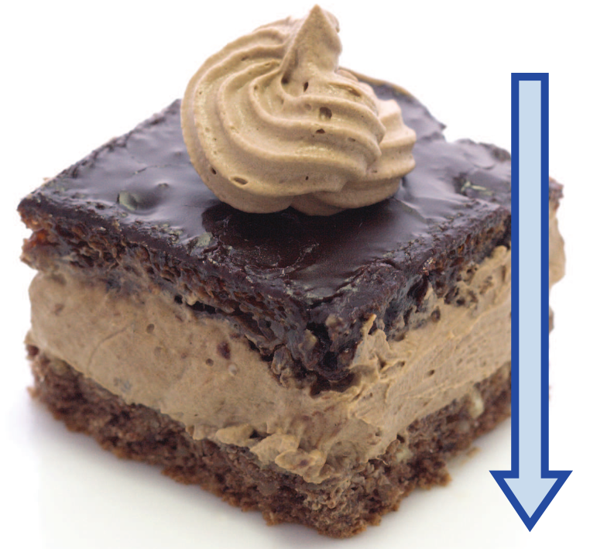
Divide the tasks
swarming
create UI
split story in tasks
implement service
divide tasks among pairs
create domain
estimate tasks (use for burndown)
set up DB
re-pair, one story lead
call webservice
Notes:
Often one pair will check in an interface. Then you divide: one pair will implement it, the other will use it.
repairing! Not same pair that always does the GUI
Story leads sticks with story, responsible to get it to done, delegate if necessary

Slide 14
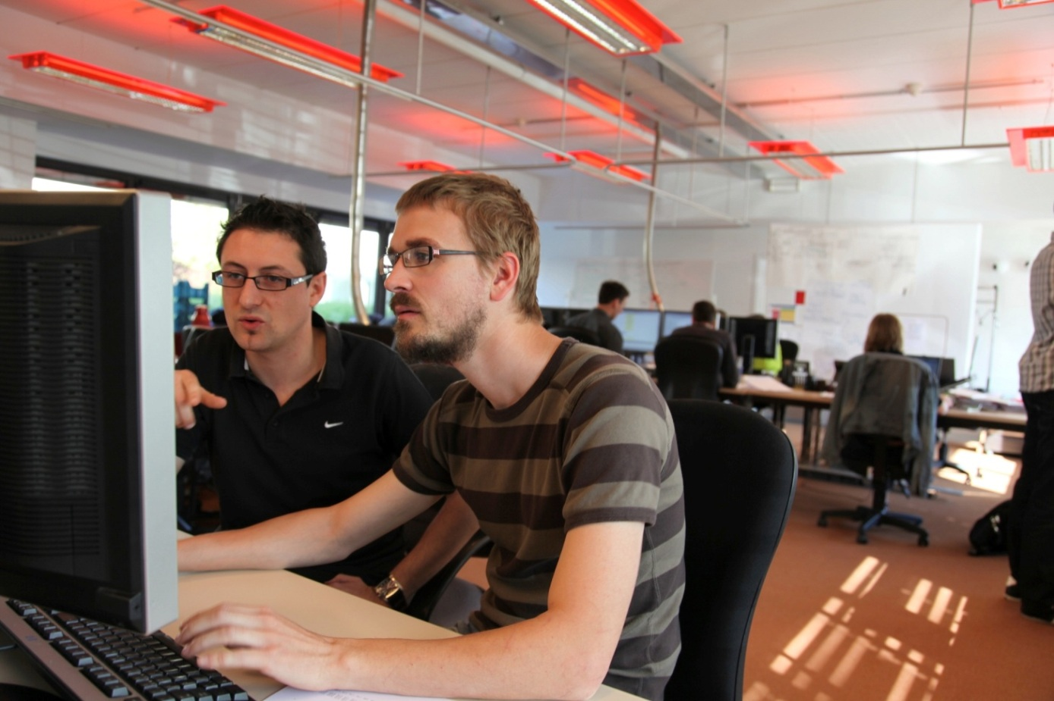
Pair programming
driver/navigator
switch roles
continuous code review
share knowledge and skills
Notes:
2 min
Pair programming is of course the most visible feature of XP development.
Two pair of eyes for everything.
Advantages
-increased confidence
-more discussion about design due to the second opinion of your pair
-less bugs
Driver: typt code in, lost syntax fouten op
Navigator: denkt vooruit, groter beeld ‘zijn we goed bezig?’
Wisselen van rol: 15 minuten, bvb ook iemand schrijft test, andere implementeert.
Herpairen: 1 keer per dag. – story lead blijft bij story.

Slide 15
Risks
the HTML guy is sick
the Person.CS guy is sick
merge 1000 lines of code at end of sprint
don’t change the code, it will introduce regression bugs
customer wanted something else
the design is a mess
everyone is leaving the project
but it worked on my machine

Slide 16

Technological diversity
the HTML guy is sick
everyone is familiar with technology used in project
sharing knowledge:
info sessions & pairing
generalist > specialist
Notes:
2 min
generalists>specialists
all members know a bit of each technology
specialist → info sessions and pairing
knowledge not lost when member leaves

Slide 17

Shared code
the Person.cs guy is sick
Every developer changes
all the code
Collective ownership
Code conventions
Notes:
2 min
Code conventies: groeit binnen het team; kan dus in elk team andere conventies zijn.
Technologisch divers
All the code: Domain, db, service, gui

Slide 18
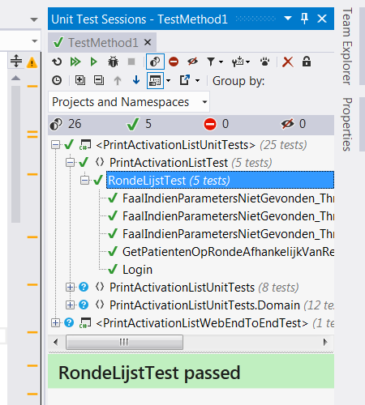
Test driven development
don’t change the code, it will introduce regression bugs
fast feedback on state of my code
safety net for catching regression
aids in design
executable documentation
Notes:
Fast feedback: you don’t have to deploy an entire application just to check if my written method works
Safety net: trust
Aids in design => if it is hard to write the test, is the design ok?

Slide 19
Test driven development
Write test
Run test
Write code
Run test
Refactor
Notes:
* Write a test: this is an automated, repeatable test (using a jUnit style framework)
Run test: it is red… ánd because of the correct reasons
Write just enough code to pass the test (limit scope) – this ensures a good coverage of your code
Run test to see if it works
Refactor code/test if necessary, use tests as safety net
* Repeat entire cycle again and again

Slide 20
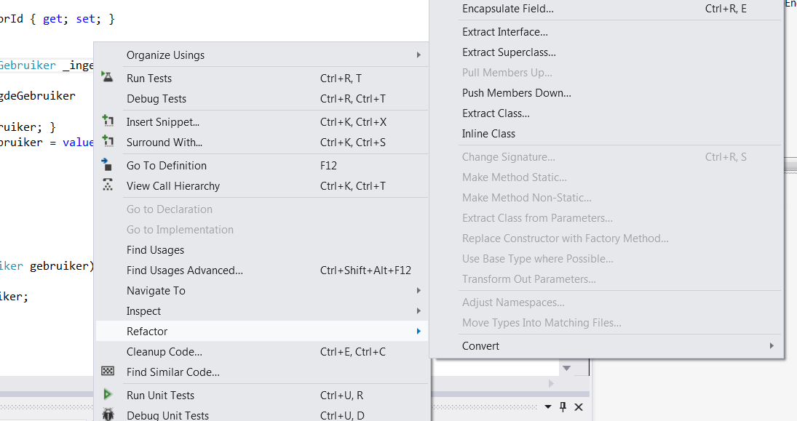
Refactoring
the design is a mess
improve structure of code
keep functionality
code smells
part of TDD cycle

Slide 21
Refactoring
Run tests
Improve structure little bit
Run tests
Improve structure little bit more
Run tests
Notes:
Important to move in small steps, so you know what caused test failures.

Slide 22

Sustainable pace
everyone is leaving the project
no overtime (all the time)
pleasant working environment
don’t kill coworkers when they make a mistake

Slide 23
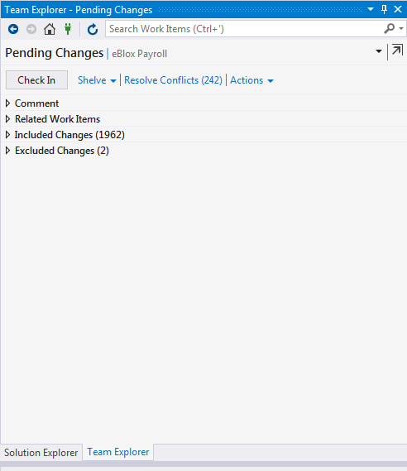
Continuous integration
merge 1000 lines of code at end of sprint
check in code multiple times a day
small pieces
tell rest of team

Slide 24


Git workflows
Notes:
In veel voorgestelde git workflows wordt er lang gewacht met effectief code integreren. Denk aan continuous integration

Slide 25
Continuous integration
Develop
Update latest code
Run tests
Check in code
Notes:
Develop: red green refactor
Update latest code
Run all tests to check merge results
Check in code
Do this multiple times a day

Slide 26
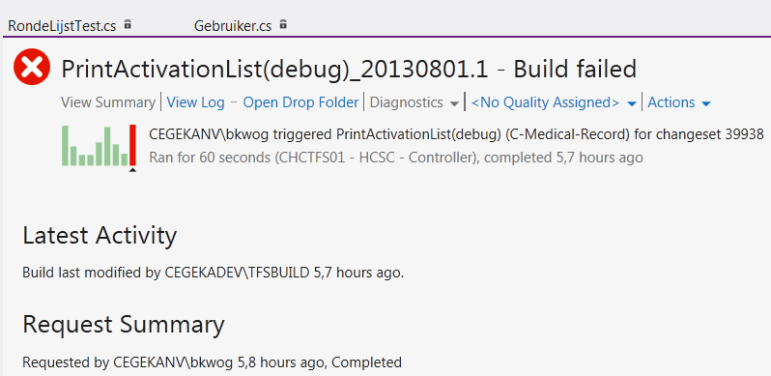
Continuous build
but it worked on my machine
automated build (TFS)
build potentially shippable product
clean environment
several times a day
tool: TeamCity, TFS,…

Slide 27
Continuous build
Check out source code
Clean DB, environment,…
Build and test
Publish report
Deploy to server
Notes:
Very bad : should be fixed immediately since no more potential shippable product this time.
Fetch all code that was checked-in by developers
Configure environment and server
Compile all code + run unit tests
Deploy on server
Run integration tests
Publish report
Can contain server log, modification set, code audits, …
If build failed: contains failing tests
If build was successful
Tag all code on CVS
Check in deployment file + tag
Shippable product
Installed in acceptance / production environment

Slide 28
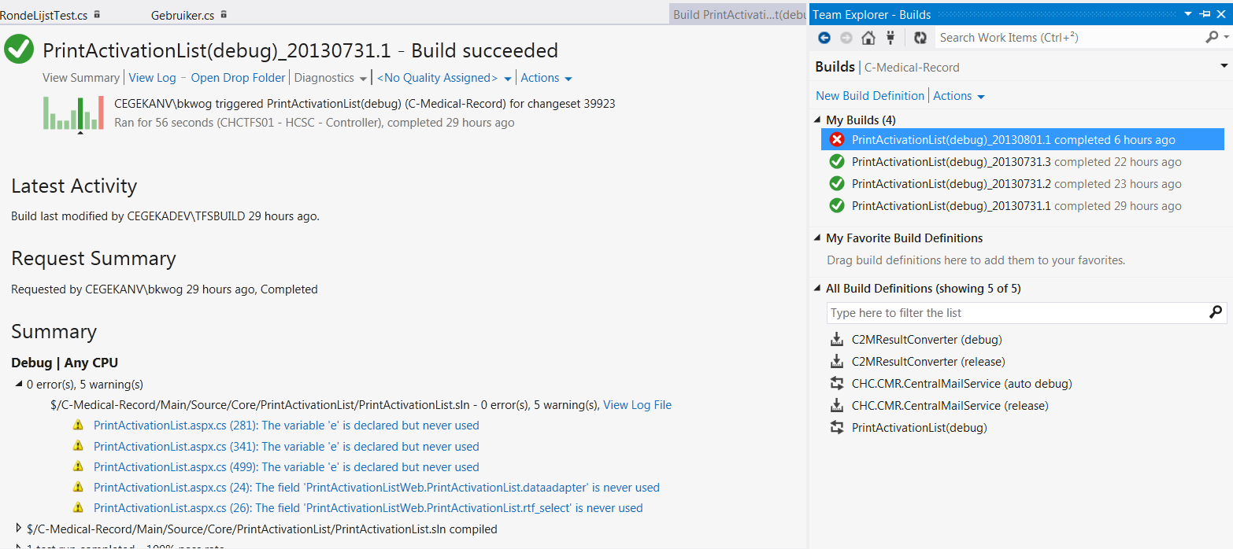
Team Foundation Server

Slide 29
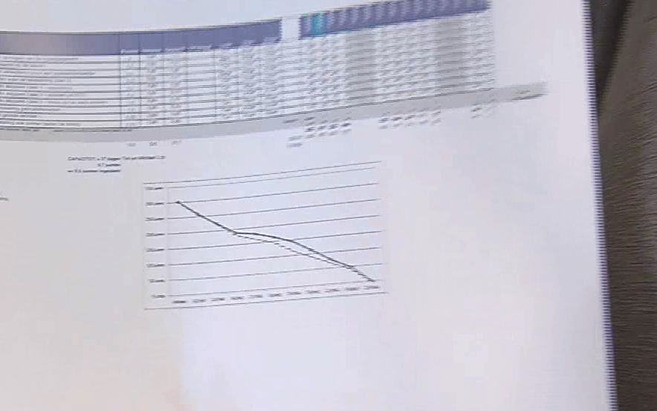
Get fast feedback
customer wanted something else
During story: ask and show proxy
End of story: show proxy/review
End of sprint: demo all stories to customer
Small releases!

Slide 30
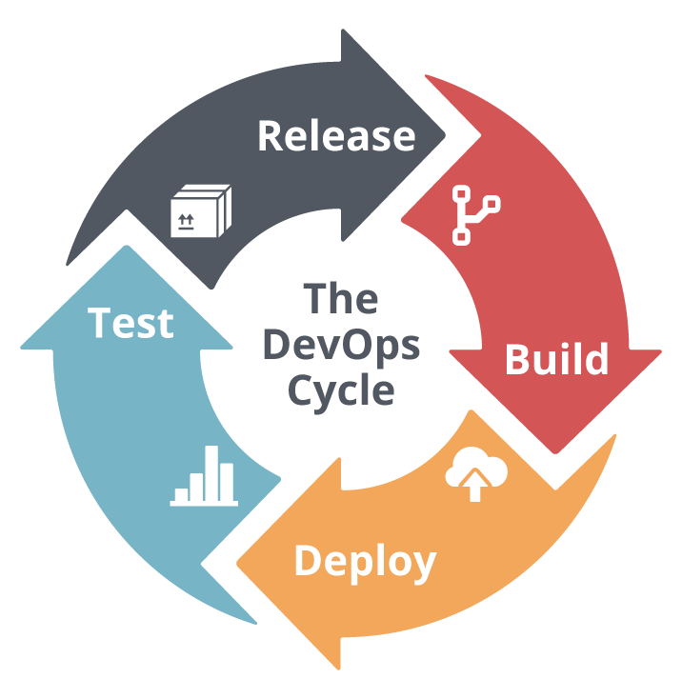
Continuous delivery
It takes days to deploy
automated config + deploy
Tool: TFS Release management, octopus deploy,…
Include getting DB up to date
DevOps
Notes:
first do a checkout of a version (for acceptance or production)
Then do a rollout to environment – selecting some options (db or not, config of server or not, which components to deploy), environment can be acceptance, prod, sanity, …
Rollout itself does:
Run db scripts
Configure application server
Data sources
Startup params
Queues
Create directories
Restarts
Deploys application
DevOps creates virtual images with an os, application server, other tools needed on.
Team basically responsible for not just development, but also the release in production and keeping it running. Might need extra expertise in team that is currently in separate operation division/dev support/…

Slide 31

Test driven development
Notes:
Luc

Slide 32
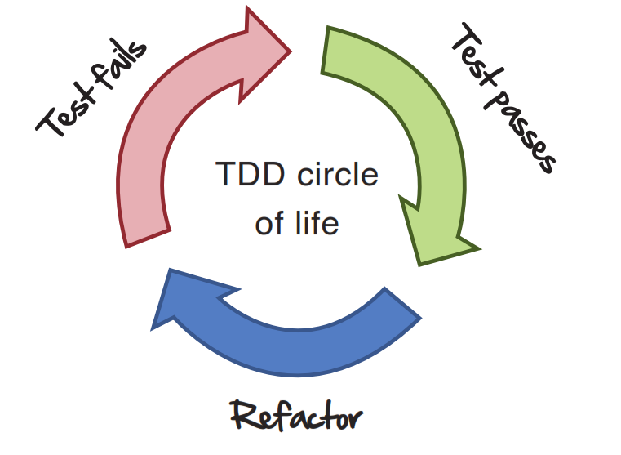
Test driven development
Notes:
Schrijf 1 test => baby step: mini stukje functionaliteit
Faalt => controleer of hij om de juiste reden faalt (want anders heb je misschien niet het juiste getest)
Driver / navigator => stel dat de driver iets implementeert zonder EERST een test te schrijven => melden ☺

Slide 33
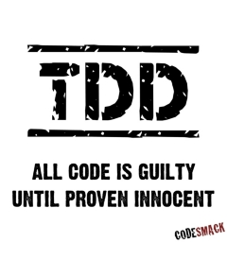
Rules of the game
The 3 laws of TDD
You are not allowed to write any production code unless it is to make a failing unit test pass.
You are not allowed to write any more of a unit test than is sufficient to fail; and compilation failures are failures.
You are not allowed to write any more production code than is sufficient to pass the one failing unit test.
Notes:
Be pragmatic, getters and setters do not need a unit test

Slide 34
Why test?
Why test first?
trust
check if test is correct
quick feedback
ensures all paths of code are covered
executable documentation
think of code from an API perspective
less bugs (but not zero!)
easier for pair to follow along
Notes:
Check if test is correct => assume you first write your code, then the test, and the test is green. Are you sure the test is correctly testing the code? In test first you first have a failing test, you check if it is failing because of the correct reason.

Slide 35
Good test
automated
fast
repeatable
independent
focused
readable

Slide 36
NUnit example
[TestFixture]
public class PersonShould
{
[Test]
public void ConcatenateNameAndFirstName_WhenAskingFullName()
{
var person = new Person("Naam", "Voornaam");
var result = person.FullName;
Assert.AreEqual("Voornaam Naam", result);
}
}
Notes:
Test Run: runs a method, a test case or a suite
Test Results: result returned by a test run

Slide 37
[SetUp] [TearDown]
[TestFixture]
public class PersonShould
{
private Person _person;
[SetUp]
public void CreatePerson()
{
_person = new Person("Naam", "Voornaam");
}
[Test]
public void ConcatenateNameAndFirstName_WhenAskingFullName() {…}
[Test]
public void ReturnNewFullName_WhenChangingFirstName() {…}
}
Notes:
[SetUp] runs method before each test. [TearDown] runs method after each test. Interesting to setup or teardown data.

Slide 38
[TestCase]
[TestCase("Naam", "Voornaam", "Voornaam Naam")]
[TestCase("", "Voornaam", "Voornaam")]
[TestCase("Naam", "", "Naam")]
[TestCase(null, "Voornaam", "Voornaam")]
[TestCase("Naam", null, "Naam")]
public void ConcatenateNameAndFirstName_WhenAskingFullName( string name, string firstName, string expected)
{
var person = new Person(name, firstName);
var result = person.FullName;
Assert.AreEqual(expected, result);
}
Notes:
See NUnit documentation for more examples

Slide 39

Demo delayed

Slide 40
Delayed
A Train has as state hoursDelayed
You have to implement the customerSatisfaction() method given following rules:
0 hours: “Nice ‘n’ rolling!”
1 hour: “Just another day at the train …”
2 hours: “This train is annoying me!”
3 hours: “B-u-u-urn it!”
> 3 hours: The world explodes (exception is thrown)

Slide 41
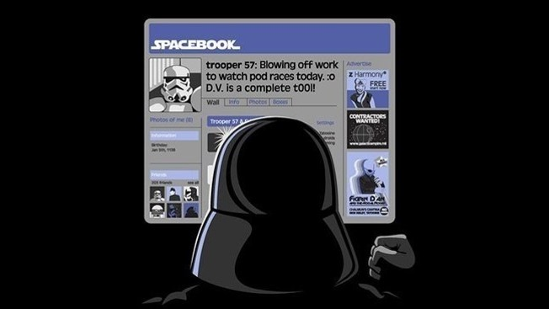
labs

Slide 42

Also when fixing bugs
Write a failing test reproducing bug
Fix bug
Refactor code
Check-in
no regression
Notes:
Wouter
Conclusion: bug does not come again
Example Fixbug Period:
boundary case: in range should return true if on ending or starting date!

Slide 43

labs

Slide 44
Types of tests
End-to-end test
Integration test
Unit test

Slide 45
Unit test
independent of external resources (DB, Webservice,…)
fast
a lot of tests
test normal execution path
active enemy of the code
test boundary conditions

Slide 46
Integration test
test integration with external resources (DB, Webservice,…)
test integration of different layers (run app in container)
is slower
less cases
Notes:
Complexer om te schrijven (configuratie extern systeem)
Op een nog niet gedeployed systeem
Soms geen unit test

Slide 47
End-to-End test
test entire application (driving browser)
don’t test all boundary conditions
slow, harder to maintain
integration of all components
Notes:
Bijvoorbeeld:
Persoon met verschillende business regels: in unit test al die regels
End-to-end: meer nagaan of het mechanischme werkt (1 regel afchecken bijvoorbeeld om te zien of foutboodschappen op het scherm komen)

Slide 48
Unit tests
Client
Presentation
Application service
Domain
Infrastructure
Browser
GUI class
Service
Business Object
DB
Hibernate
Business Object
Data
RDBMS
Notes:
voorbeeldje van onze layered architecture

Slide 49
Unit tests
Client
Presentation
Application service
Domain
Infrastructure
Browser
GUI class
Service
Business Object
DB
Hibernate
Business Object
Data
RDBMS
Unit can be bigger than a class!
Notes:
But they are independent from infrastructure/frameworks/…

Slide 50
Integration tests
Client
Presentation
Application service
Domain
Infrastructure
Browser
GUI class
Service
Business Object
DB
Hibernate
Business Object
Data
RDBMS
Notes:
voorbeeldje van onze layered architecture

Slide 51
Integration tests
Client
Presentation
Application service
Domain
Infrastructure
Browser
GUI class
Service
Business Object
DB
Hibernate
Business Object
Data
RDBMS
Notes:
voorbeeldje van onze layered architecture

Slide 52
End to end test
Client
Presentation
Application service
Domain
Infrastructure
Browser
GUI class
Service
Business Object
DB
Hibernate
Business Object
Data
RDBMS
Notes:
voorbeeldje van onze layered architecture

Slide 53
So I want to write a unit test…
PersonTest
Person
CountryRepository
RDBMS
… but my object has annoying dependencies!
Notes:
Hoe?
A component uses a mail service.
Be able to test component without using an actual mail service.
We only want to test the behaviour of the component and the interaction with the mail service.
We do not want to test the mail service again.
Be able to test unexpected behaviour (failing mail service)
=> We want to write unit tests not integration tests.

Slide 54
During test, replace dependency
PersonTest
Person
CountryRepositoryMock
CountryRepositoryMock has same interface as CountryRepository
Notes:
Hoe?
A component uses a mail service.
Be able to test component without using an actual mail service.
We only want to test the behaviour of the component and the interaction with the mail service.
We do not want to test the mail service again.
Be able to test unexpected behaviour (failing mail service)
=> We want to write unit tests not integration tests.

Slide 55
Tests sets up mock
PersonTest
Person
CountryRepositoryMock
Return “BE,NL” when your getValidCountries() is called
Notes:
Hoe?
A component uses a mail service.
Be able to test component without using an actual mail service.
We only want to test the behaviour of the component and the interaction with the mail service.
We do not want to test the mail service again.
Be able to test unexpected behaviour (failing mail service)
=> We want to write unit tests not integration tests.

Slide 56
Tests excercises object
PersonTest
Person
CountryRepositoryMock
person.moveTo(“NL”)
Notes:
Hoe?
A component uses a mail service.
Be able to test component without using an actual mail service.
We only want to test the behaviour of the component and the interaction with the mail service.
We do not want to test the mail service again.
Be able to test unexpected behaviour (failing mail service)
=> We want to write unit tests not integration tests.

Slide 57
Object will call mock
PersonTest
Person
CountryRepositoryMock
getValidCountries() (returns “BE,NL”)
Notes:
Hoe?
A component uses a mail service.
Be able to test component without using an actual mail service.
We only want to test the behaviour of the component and the interaction with the mail service.
We do not want to test the mail service again.
Be able to test unexpected behaviour (failing mail service)
=> We want to write unit tests not integration tests.

Slide 58
Can simulate failures
PersonTest
Person
CountryRepositoryMock
When getValidCountries() is called, throw an DatabaseDownException
Notes:
Hoe?
A component uses a mail service.
Be able to test component without using an actual mail service.
We only want to test the behaviour of the component and the interaction with the mail service.
We do not want to test the mail service again.
Be able to test unexpected behaviour (failing mail service)
=> We want to write unit tests not integration tests.

Slide 59

RhinoMock
public interface ISubscriber
{
void Receive(string message);
}
public class Publisher
{
public ISubscriber Subscriber { get; set; }
public void Publish(string message)
{
Subscriber.Receive(message);
}
}

Slide 60
[TestFixture]
public class PublisherShould
{
private Publisher _publisher;
private ISubscriber _subscriberMock;
[SetUp]
public void SetupPublisher()
{
_subscriberMock = MockRepository.GenerateMock<ISubscriber>();
_publisher = new Publisher()
{
Subscriber = _subscriberMock
};
}
[Test]
public void SendMessageToReceiver()
{
_publisher.Publish("Hello");
_subscriberMock.AssertWasCalled(s => s.Receive("Hello"));
}
}
Notes:
*

Slide 61
Documentation
Setup the mock to return value, to throw exception, assert not called, …
https://hibernatingrhinos.com/oss/rhino-mocks
http://portal.sd.dika.be/sites/ITServices/method/Architectuur/Documentation/TA/Current/HTML/index.html?sdframework_unittesting_mocking.htm

Slide 62
SDFramework -> BDD ContextSpecification
[TestFixture]
public class PublisherShould : ContextSpecification<Publisher>
{
protected override void Because()
{
SUT.Publish("Hello");
}
[Test]
public void SendMessageToReceiver()
{
Dependency<ISubscriber>().AssertWasCalled(s => s.Receive("Hello"));
}
}

Slide 63
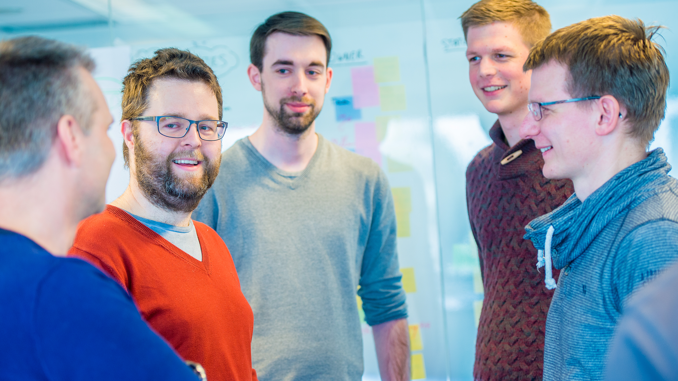
demo
Greeting

Slide 64
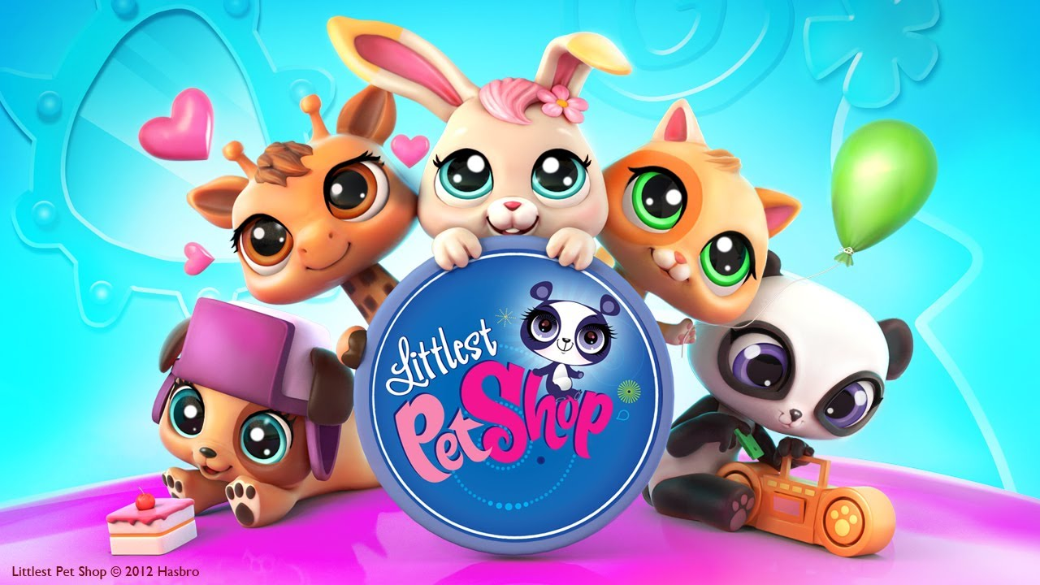
Lab (Petshop + flight)

Slide 65
Where to mock
SavePersonHandler
SavePersonHandler
under test
under test
Validator
PersonService
Validator
PersonService
mock
mock
PersonRepository
PersonRepository
Notes:
Voordelen? Nadelen?
Goeie afspraken rond boundaries binnen team maken

Slide 66
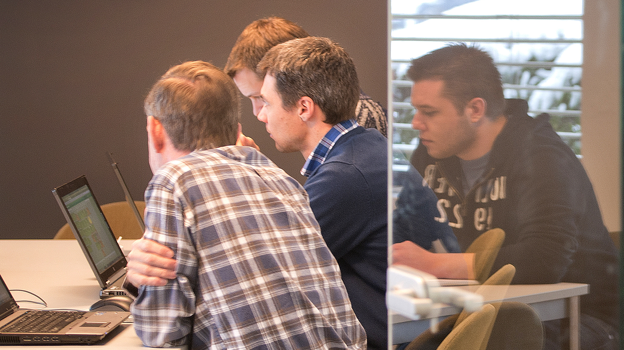
Refactoring
Notes:
Luc
2 min

Slide 67
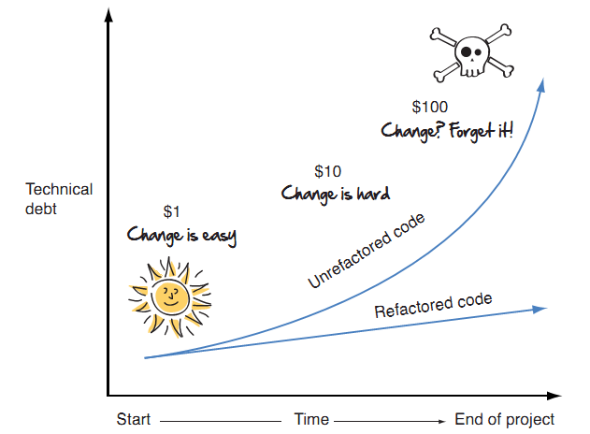
Ugly code is hard to change
Understandable, maintainable, readable code

Slide 68

Why?
Broken window syndrome
“If a window in a building is broken and left unrepaired, all the rest of the windows will soon be broken…”
maintainable and adaptable
understandable code
explains functionality better (readable)
detect errors in code
develop faster

Slide 69
Refactoring
Keep the code clean
Run tests
Improve structure little bit
Run tests
Improve structure little bit more
Run tests
change structure of the code
functionality doesn’t change
unmodified tests still work

Slide 70
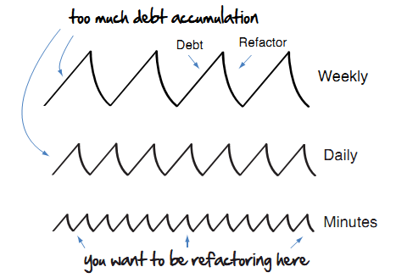
When?
always (fixing bugs, developing stories)
before implementing functionality
while reading code
NO ‘refactor sprints’
Notes:
altijd: constant proces, geen refactorsprints/refactordag, gewoon tijdens stories;bugfixing;..
vergt soms wel courage, maar is de moeite waard. een goeie testset kan een grote hulp zijn

Slide 71
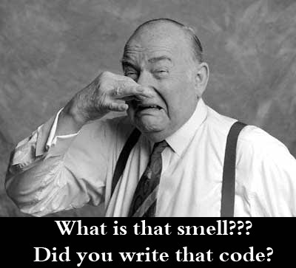
Code smells
typical bad code structure
improve by refactoring
production- and test code
eg: duplicate code, long method, feature envy

Slide 72

Duplication
the root of all evil
same code structure in more than one place
same functionality implemented differently
in different places
Extract Method, Form Template, Extract Class
Notes:
P 76
Not necessarily in the same method or class
Can be in sibling subclasses
Can even be in totally unrelated classes
Must not be exactly the same
Example: Iterate over collection for some calculation using for loop <> while loop
Do the same thing using a different algorithm

Slide 73

Long method
multiple responsibilities
difficult to understand
difficult to reuse
comments in method?
Extract Method, Replace Temp with Query
Notes:
P 77

Slide 74
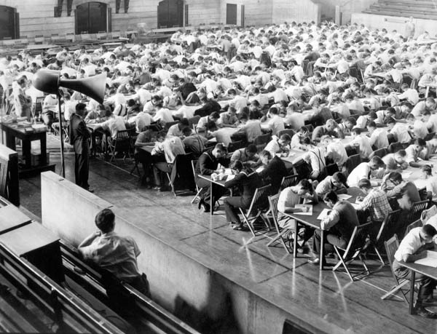
Large class
multiple responsibilities
difficult to understand
difficult to reuse
a lot of instance variables
instance variables prefixed
Extract (Sub)Class
Notes:
P 77

Slide 75

Feature Envy
public class PaperBoy {
public void DeliverPaper(Customer customer) {
var customerWallet = customer.Wallet;
if (customerWallet.TotalMoney > payment) {
customerWallet.SubstractMoney(payment);
}
}
}
class is more interested in variables of another class
tell don’t ask
Extract and Move Method
Notes:
P 78

Slide 76
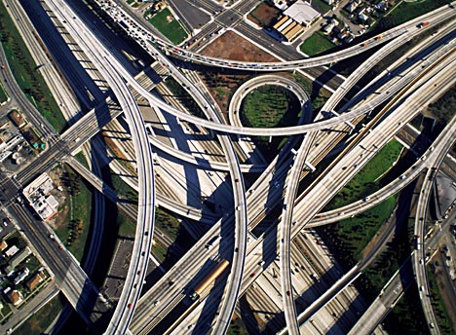
Switch
same switch on different places
switch on type
error prone
difficult to adapt
Replace Type Code with Subclass, Replace Conditional with Polymorphism
Notes:
moeilijk aanpasbaar: als je functionaliteit toevoegt => waar moet je allemaal aanpassen?
These switch statements often switch on a type code
example: an integer represents the type code for an employee, a manager, a salesman, ...

Slide 77

Speculative Generality
“This feature should be added... “
“But in the next story ... “
“For sure we’re going to need...”
“ ... make it configurable?”
TDD
Stick to scope of story
unnecessary complexity

Slide 78
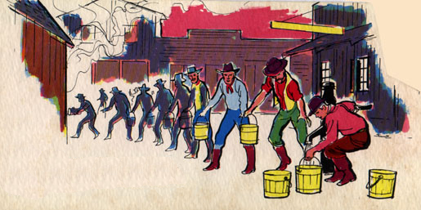
Message Chains
getCustomer().getWallet().getMoney();
high coupling
breakable
Hide Delegate, Move Method

Slide 79
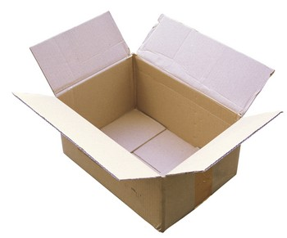
Data Class
classes with only data
data manipulated by other classes
OO?
too much behaviour in service layer,
not enough in domain layer
Move Method, Encapsulate Fields, Hide Method
Notes:
data gemanipuleerd door andere klassen => feature envy smell
DTOs voor transfer objecten -> kan nodig zijn

Slide 80

Find smells

Slide 81
Refactoring exercise
Find smells in previous exercises
In production code and tests!
Don’t refactor yet

Slide 82

Refactoring the smells
refactoring: steps to fix code smell
automatic refactor tools in IDE
chain multiple refactorings together
Notes:
Wouter

Slide 83
Rename
CTRL+R, R
change name of method/class
naming important!
name – functional term
demo
Notes:
naamgeving: komt overeen met functionele termen

Slide 84
Extract method
CTRL+R, M
group code by functionality
naming: what it does
size doesn’t matter
instead of comments
demo + exercise
Notes:
naamgeving: door een juiste naamgeving, is het niet nodig om in de methode zelf te gaan kijken
Short (body), well named methods
Promotes reuse of these methods (1 responsability)
Allows the higher-level methods to ‘read’ as a series of comments.
NAMING is very important
Drawback of many small methods: difficult to see what the submethods do, because you have to switch context
Browse to implementation with IDE easily
GOOD NAMING is very important! Method name says what the method does, no need to look at the method body
Length of the extracted method is not a issue =>Semantic difference between the method name and the method body. If extracting improves clarity, do it!

Slide 85
Replace temp with query
CTRL+R, M + CTRL+R, I
temporary variable: result of a calculation
Extract query
Inline temp
Easier to then extract multiple methods
2 temps 1 loop => 2 loops
demo
Notes:
demo: Er bij vertellen: See how it would have been difficult to extract discountFactor if I had not replaced
basePrice with a query. (want dan zou ik in discount factor hebben moeten base price herbereken :-( duplicated code )

Slide 86
Decompose Conditional
CTRL+R, M
unclear conditions
make functional reason of condition clear
Extract method on a condition
demo + exercise
Notes:
Extra advantage: reuse of extracted conditional in other methods

Slide 87
Move method
CTRL+R, V – CTRL+R, M, CTRL+R, I
feature envy
move method to correct class
Notes:
Juiste klasse: klasse van field of parameter die gebruikt wordt
Example Account overdraftCharge method
Let’s imagine that there are going to be several new account types, each of which has its own rule for calculating the overdraft charge. So I want to move the overdraft charge method over to the account type.

Slide 88
Introduce Parameter Object
(Refactor -> Extract class from Parameters)
group of parameters belong together
replace by a class
feature envy / data class
demo + exercise

Slide 89
Replace Conditional with Polymorphism
switch
subclasses + move behaviour
type instead of int
easier to extend
Notes:
Mechanics
------------
Create abstract class EmployeeType
Create method <abstract int getTypeCode>
Create Manager, SalesMan, Engineer and extend getTypCode → “return Employee.*”
In Employee: replace “int type” by “EmployeeType type”
getType() in Employee returns “type.getTypeCode()”
setType() in Employee switches on “int arg” and sets type
RUN TESTS
Move static final ints from Employee to EmployeeType (use eclipse to move to avoid compile errors)
Create static “EmployeeType newType()” on EmployeeType and copy swich from Employee.setType to newType()
Delegate Employee.setType to EmployeeType.newType()
RUN TESTS
Create method payAmount() on EmployeeType and copy switch from Employee.payAmount
Replace getType() in switch by getTypeCode()
Add parameter Employee to EmployeeType.payAmount and fix compile errors in switch
Delegate Employee.payAmount to EmployeeType.payAmount
RUN TESTS
Override payAmount in each subclass of EmployeeType, move each case of the switch to corresponding subclass, replace the case of switch with “throw new RuntimeException(...)”, RUN TEST and then finally remove the case in the switch.
Make EmployeeType.payAmount abstract
RUN TESTS
Do a little dance

Slide 90
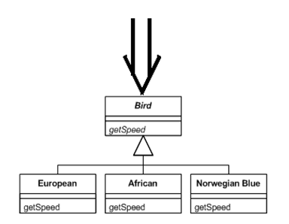
Replace conditional with polymorphism
double getSpeed() {
switch (_type) {
case EUROPEAN:
return getBaseSpeed();
case AFRICAN:
return getBaseSpeed() - getLoadFactor() * _numberOfCoconuts;
case NORWEGIAN_BLUE:
return (_isNailed) ? 0 : getBaseSpeed(_voltage);
}
throw new RuntimeException("should be unreachable");
}

Slide 91
In Practice
code always compiles
baby steps
green tests after each step
IDE
tests: add, change, move, mocking ...
Notes:
IDE: preview
Na iedere stap test: om zo te weten welke wijziging bij welke falende test hoort. Veel stappen en dan testen: moeilijk te achterhalen

Slide 92


http://martinfowler.com/refactoring/catalog/index.html

Slide 93
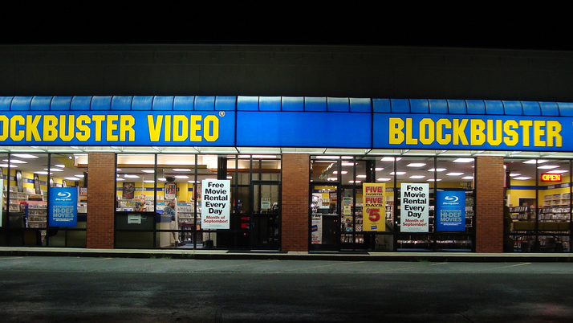
Lab

Slide 94
Test code smells
Keep it as clean as your production code
duplication
fragile test
dependent
slow test
test hard to write
often sign of bad code (high coupling, low cohesion,…)
Notes:
breekbare test: je wijzigt klein beetje productie code en er falen meer dan n testen; testen die soms falen => brakke datum check; random; volgorde belangrijk
geen focus => assertion roulette: 1 test met 20 asserts op

Slide 95
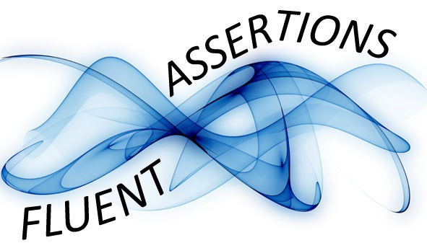
Fluent Assertions
string actual = "ABCDEFGHI";
actual.Should()
.StartWith("AB")
.And.EndWith("HI")
.And.Contain("EF")
.And.HaveLength(9);
Nice extra methods for writing asserts

Slide 96
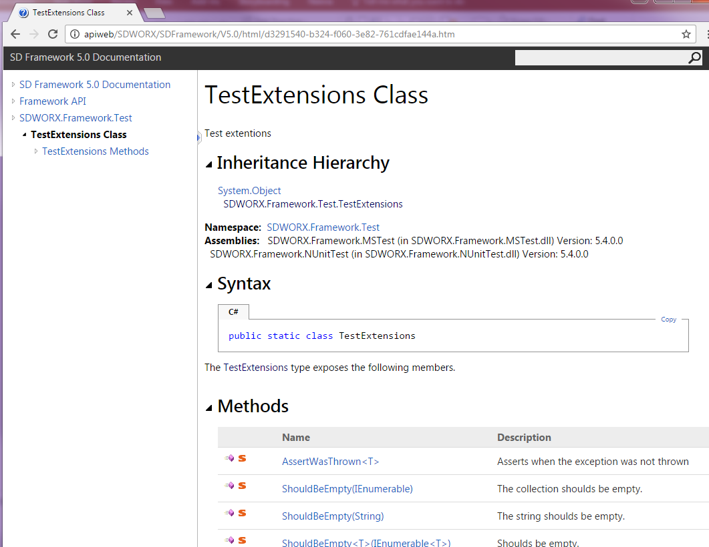
SD Framework
http://apiweb/SDWORX/SDFramework/V5.0/

Slide 97
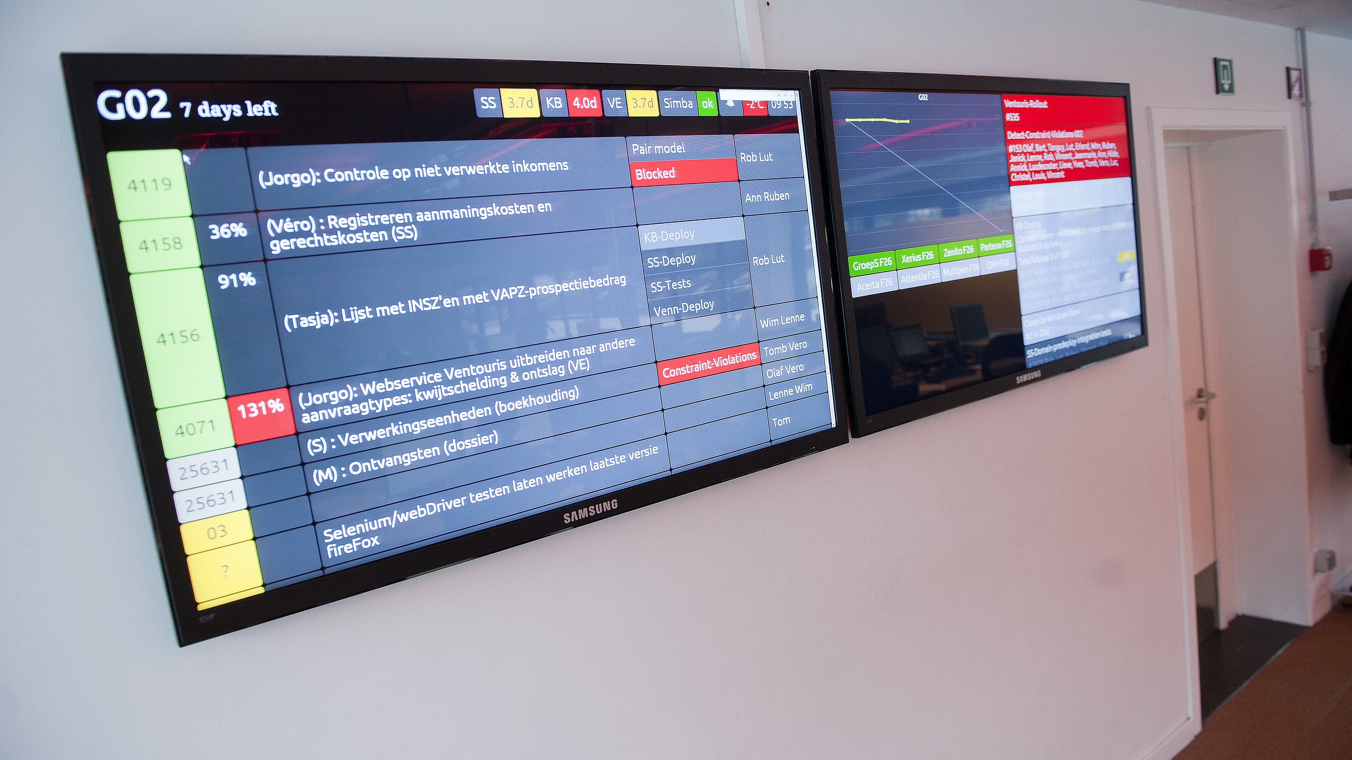
Test object builders
Notes:
To make testing more readable, you can use also test builders (such as Customer Builder in the movie rental). Sometimes it is difficult to create a completely valid object, every time you want to use it in a test. Instead, you use a test object builder to give you back a valid default object, which you can adjust the necessary items if necessary.

Slide 98
public class Supplier
{
private string _name;
public Supplier(string name)
{
_name = name;
}
}
public class Vacancy
{
private string _functionName;
private Supplier _supplier;
private string _contactPerson;
public Vacancy(string functionName, Supplier supplier)
{
_functionName = functionName;
_supplier = supplier;
}
}

Slide 99
Test Object Builders
Vacancy vacancy = new VacancyBuilderForTests().Build();
=> valid Object, default values
Vacancy vacancy = new VacancyBuilderForTests()
.WithFunction("Architect")
.WithSupplier(new SupplierBuilderForTests()
.WithName("Some IT company")
.Build())
.Build();
=> override defaults, nested builders

Slide 100
public class SupplierBuilderForTests
{
public static readonly string DEFAULT_NAME = "Cegeka";
private string _name = DEFAULT_NAME;
public Supplier Build()
{
return new Supplier(_name);
}
public SupplierBuilderForTests WithName(string name)
{
_name = name;
return this;
}
}
public class VacancyBuilderForTests {…}

Slide 101
public class SupplierBuilderForTests
{
public static readonly string DEFAULT_NAME = "Cegeka";
private string _name = DEFAULT_NAME;
public Supplier Build()
{
return new Supplier(_name);
}
public SupplierBuilderForTests WithName(string name)
{
_name = name;
return this;
}
}
public class VacancyBuilderForTests {…}

Slide 102
public class SupplierBuilderForTests
{
public static readonly string DEFAULT_NAME = "Cegeka";
private string _name = DEFAULT_NAME;
public Supplier Build()
{
return new Supplier(_name);
}
public SupplierBuilderForTests WithName(string name)
{
_name = name;
return this;
}
}
public class VacancyBuilderForTests {…}

Slide 103
Add common business cases
public class SupplierBuilderForTests
{
public Supplier Build() {…}
public SupplierBuilderForTests IsFast()
{
this.deliveryTime = TimeSpan.FromDays(4);
return this;
}
public SupplierBuilderForTests Unreliable()
{
this.status = Reliability.Unreliable;
this.numberOfRetries = 7;
return this;
}
}

Slide 104

lab

Slide 105
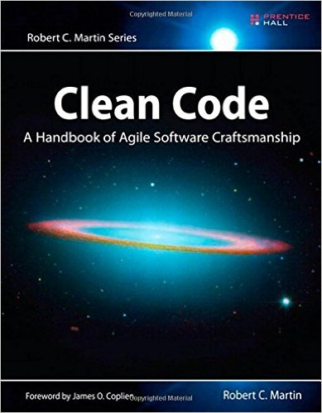

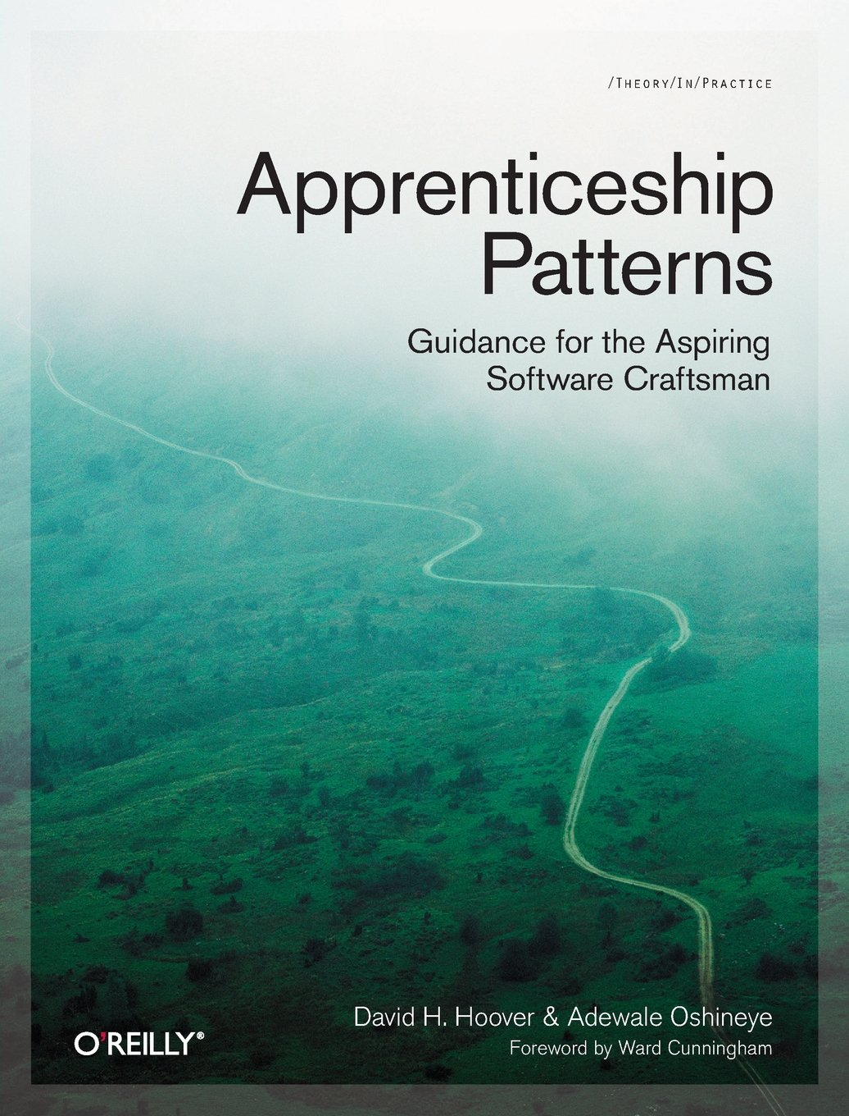




Learn more - books

Slide 106

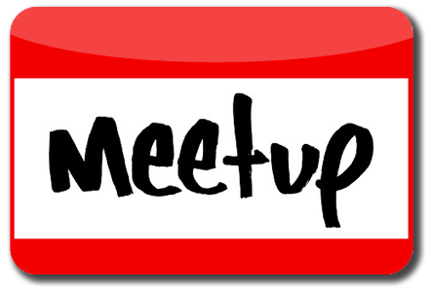

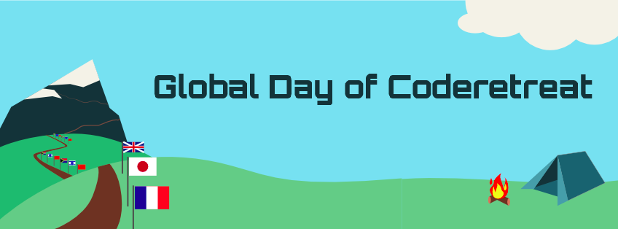
Learn more - others
Code katas

Slide 107
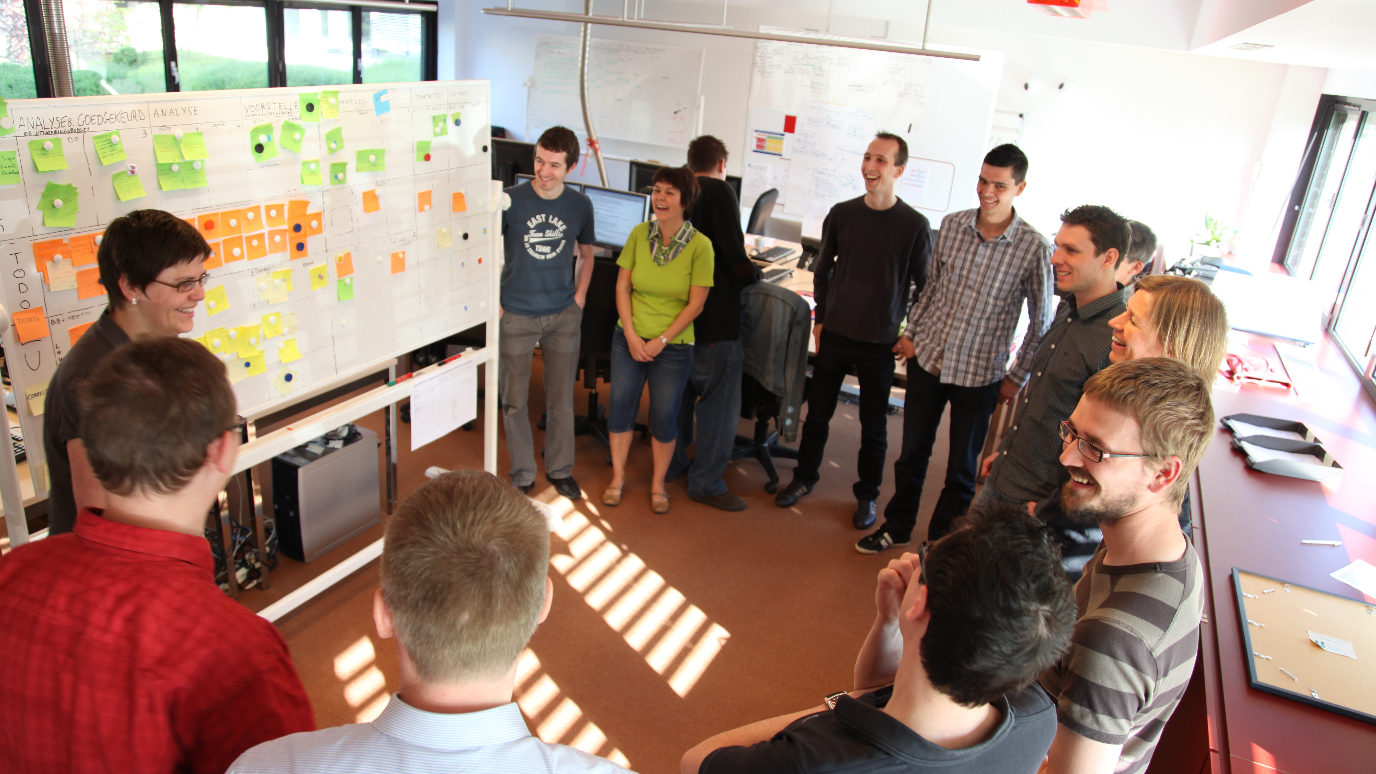
The end

